Slide 1
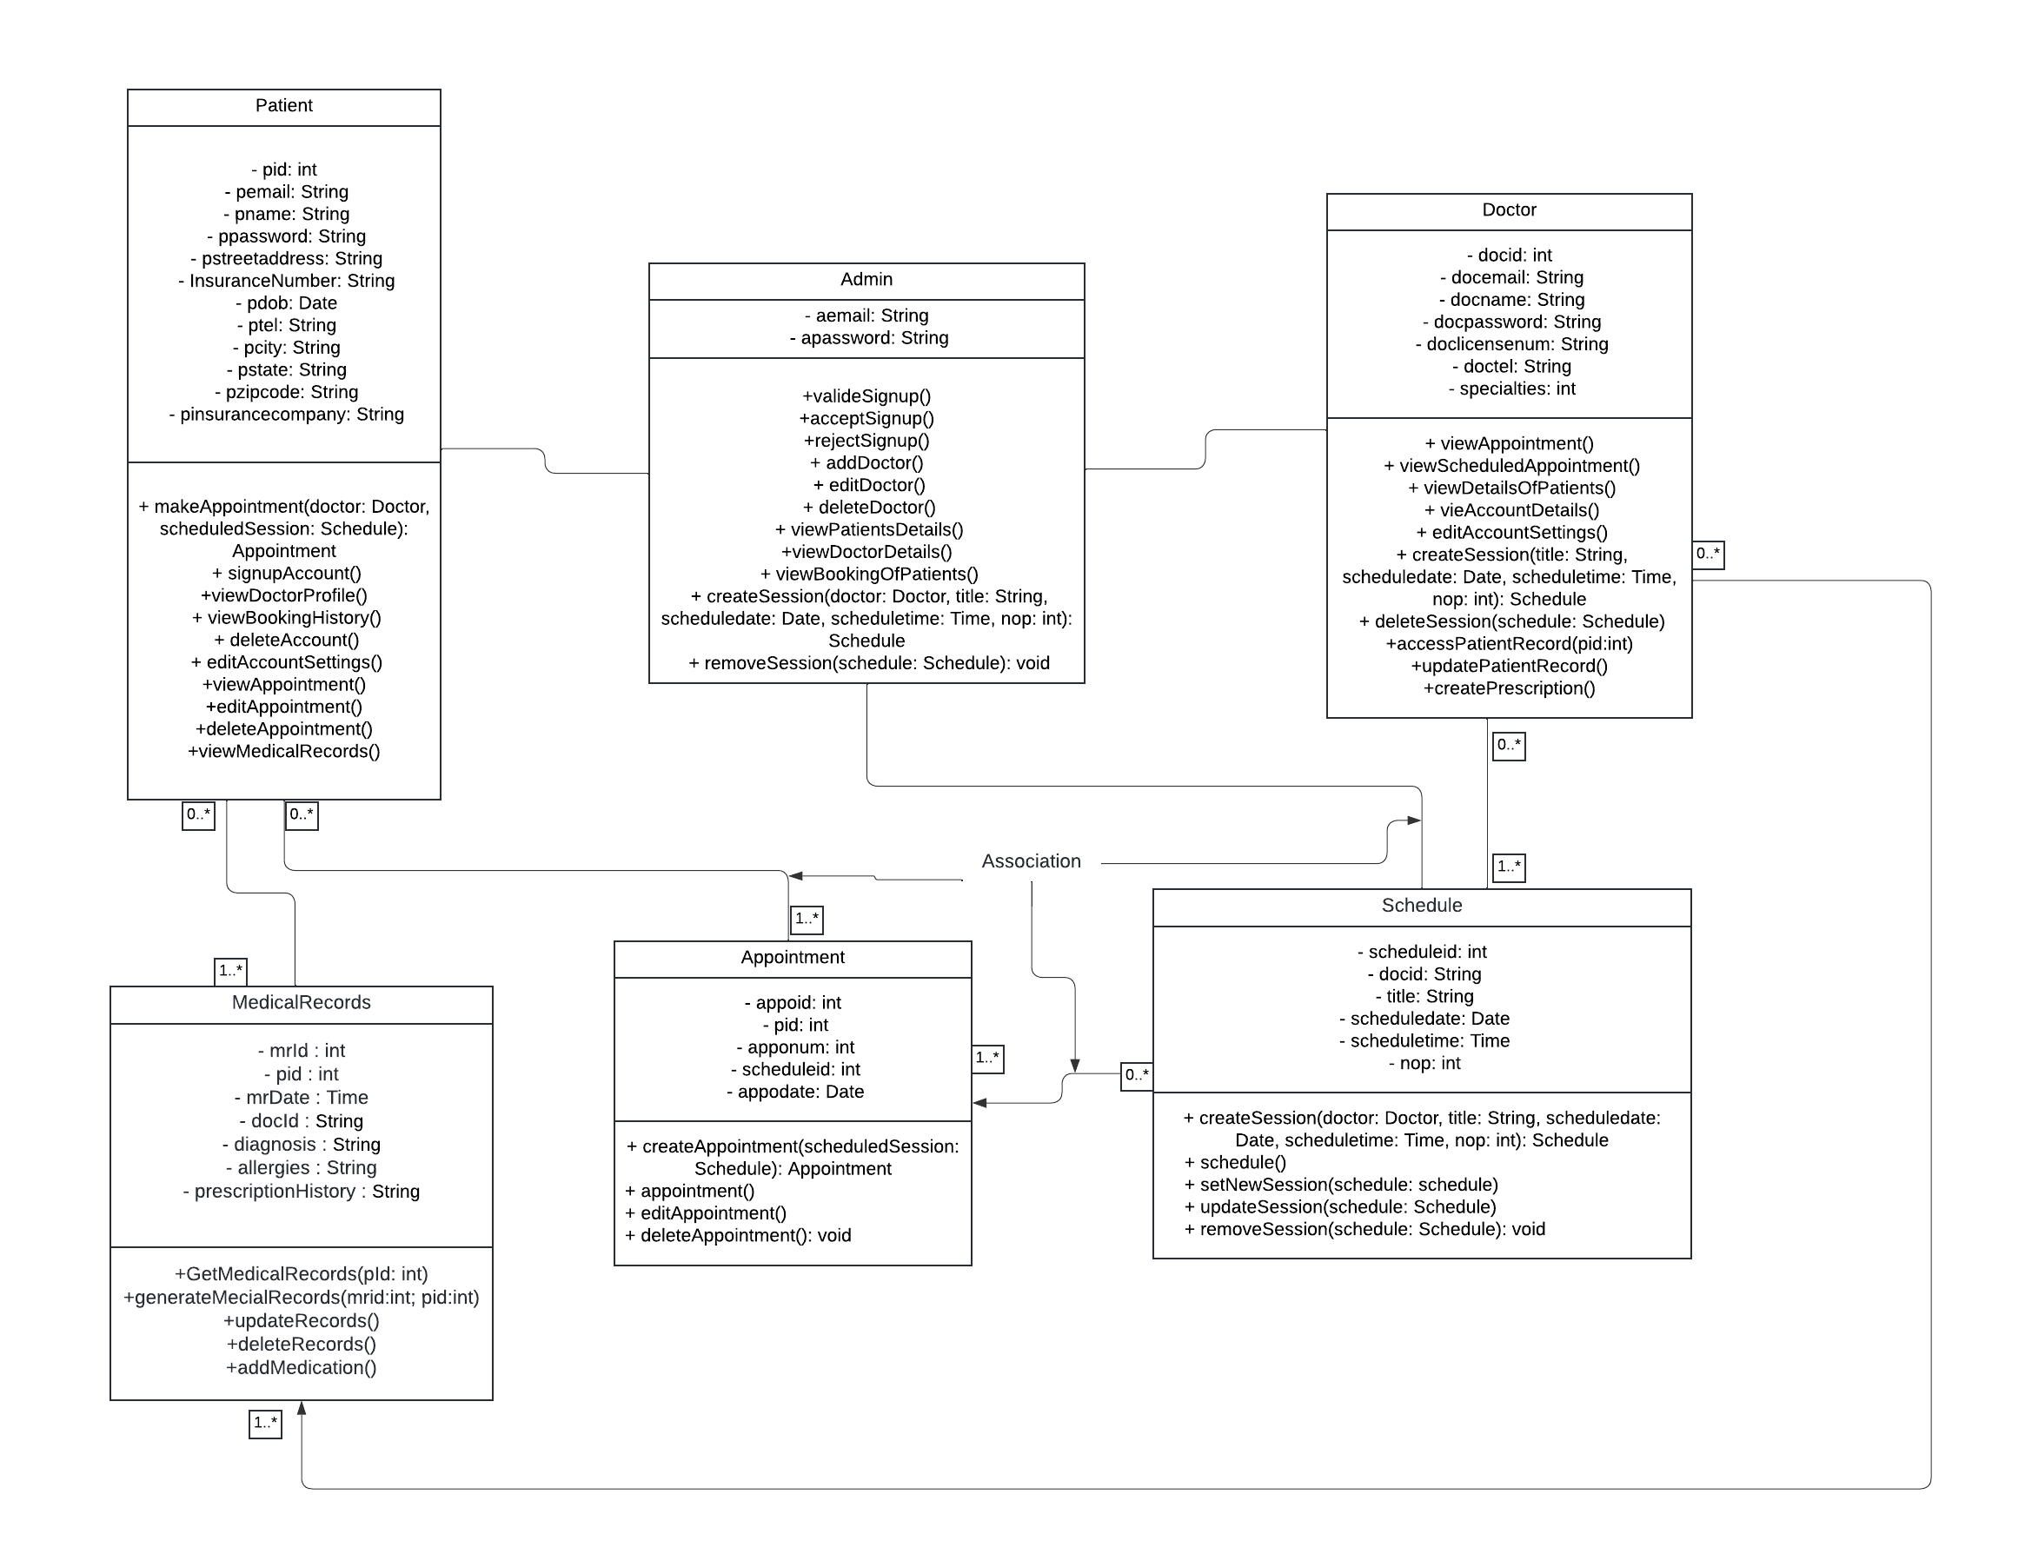
Class Diagram (Patient Portal)

